Slide 1
Basics of C#

Slide 2
Overview
C# is pronounced as "C-Sharp".
It is an object-oriented programming language provided by Microsoft that runs on . Net Framework.
Anders Hejlsberg is known as the founder of C# language.
C# has evolved much since their first release in the year 2002.
It was introduced with .NET Framework 1.0
The most recent version is 9.0, which was released in 9.0 / November 10,2020 in .NET 5.0 and included in Visual Studio 2019 version 16.8.

Slide 3
To Develop Applications
By using c # we can develop
Mobile applications
Desktop applications
Web applications
Web services
Web sites
Games
Database applications

Slide 4
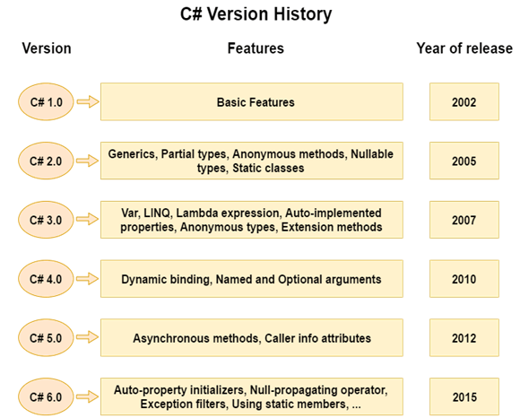

Slide 5
Basic Program in c#
using System;
namespace Test
{
class Program
{
public static void Main(String args[])
{
Console.WriteLine("Hello, world!");
}
}
}

Slide 6
Program explanation
Let us look at the various parts of the given program −
using System; - the using keyword is used to include the System namespace in the program A namespace is a collection of classes.
using System means that we can use classes from the System namespace.
A namespace is designed for providing a way to keep one set of names separate from another. The class names declared in one namespace does not conflict with the same class names declared in another.
class is a container for data and methods
Program is the class name. A class is a blueprint which from objects is created
Methods define the behavior of the class.
static: is a keyword which means object is not required to access static members. So it saves memory.
void: is the return type of the method. It does'treturn any value. In such case, return statement is not required.

Slide 7
Program explanation
The next line defines the Main method, which is the entry point for all C# programs. The Main method states what the class does when executed.
Main: is the method name. It is the entry point for any C# program. Whenever we run the C# program, Main() method is invoked first before any other method. It represents start up of the program.
string[] args: is used for command line arguments in C#. While running the C# program, we can pass values. These values are known as arguments which we can use in the program.
System.Console.WriteLine("Hello World!"): Here, System is the namespace. Console is the class defined in System namespace. The WriteLine() is the static method of Console class which is used to write the text on the console.

Slide 8
Comments & keywords & identifiers In C#
C# comments
Comments are used for explaining code. Compilers ignore the comment entries.
The multiline comments in are start with /* and terminates with the characters */
Syntax: /* This are the multi line
comments for C# */
Single-line comments are indicated by the '//' symbol. For example,
Syntax: //This is c# programming class
C# Keywords
Keywords are reserved words predefined to the C# compiler. These keywords cannot be used as identifiers.
C# identifiers
An identifier is a name used to identify a class, variable, function, or any other user-defined item.
A name must begin with a letter that could be followed by a sequence of letters, digits (0 - 9) or underscore. The first character in an identifier cannot be a digit.

Slide 9
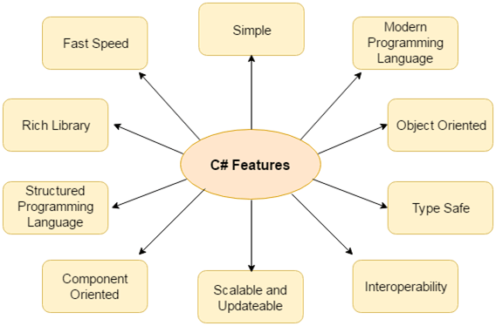
Features of c#

Slide 10
Fearures of c#
1) Simple
C# is a simple language in the sense that it provides structured approach (to break the problem into parts), rich set of library functions, data types etc.
2) Modern Programming Language
C# programming is based upon the current trend and it is very powerful and simple for building scalable, interoperable and robust applications.
3) Object Oriented
C# is object oriented programming language.
4) Interoperability
Interoperability process enables the C# programs to do almost anything that a native C++ application can do.
Interoperability of programming languages is the ability for two or more languages to interact as part of the same system. Frequently, this means passing messages and data between potentially very different languages.

Slide 11
Features of c#
5) Scalable and Updateable
C# is automatic scalable and updateable programming language. For updating our application we delete the old files and update them with new ones.
Scalability in the sense it supports for future extenstability
6) Structured Programming Language
C# is a structured programming language in the sense that we can break the program into parts using functions. So, it is easy to understand and modify.
7) Rich Library
C# provides a lot of inbuilt functions that makes the development fast.
8) Fast Speed
The compilation and execution time of C# language is fast.

Slide 12
Variables in C#
A variable is nothing but a name given to a storage area that our programs can manipulate.
Each variable in C# has a specific type, which determines the size and layout of the variable's memory the range of values that can be stored within that memory and the set of operations that can be applied to the variable.
int - stores integers (whole numbers), without decimals, such as 123 or -123
double - stores floating point numbers, with decimals, such as 19.99 or -1 1 19.99
char - stores single characters, such as 'a' or 'B'. Char values are surrounded by single quotes
string - stores text, such as "Hello World". String values are surrounded by double quotes
bool - stores values with two states: true or false
Variable Type | Example
Decimal types | decimal
Boolean types | True or false value, as assigned
Integral types | int, char, byte, short, long
Floating point types | float and double
Nullable types | Nullable data types

Slide 13
Variable Declaration
A variable can have alphabets, digits and underscore.
A variable name can start with alphabet and underscore only. It can't start with digit.
No white space is allowed within variable name.
Syntax of c#
type variableName = value;
A variable name must not be any reserved word or keyword e.g. char, float etc.
int x;
int _x;
int k20;
This how we are Initialize the variables in C#
int myNum = 5;
double myDoubleNum = 5.99D;
char myLetter = 'D’;
bool myBool = true;
string myText = "Hello";

Slide 14
Data types in C#
Data Type | Size | Description
int | 4 bytes | Stores whole numbers from -2,147,483,648 to 2,147,483,647
long | 8 bytes | Stores whole numbers from -9,223,372,036,854,775,808 to 9,223,372,036,854,775,807
float | 4 bytes | Stores fractional numbers. Sufficient for storing 6 to 7 decimal digits
double | 8 bytes | Stores fractional numbers. Sufficient for storing 15 decimal digits
bool | 1 bit | Stores true or false values
char | 2 bytes | Stores a single character/letter, surrounded by single quotes
string | 2 bytes per character | Stores a sequence of characters, surrounded by double quotes

Slide 15
3 Types Data types Value Data Type: Int , Char ,float ,short ,long , double , long Reference Data Type: The reference data types do not contain the actual data stored in a variable, but they contain a reference to the variables. if the data is changed by one of the variables, the other variable automatically reflects this change in value. There are 2 types of reference data type in c # language. 1) predefined types - such as objects, string. 2 ) user defined types - such as classes, interface.
Types | Data Types
Value Data Type | short, int , char, float , double etc
Reference Data Type | String, Class, Object and Interface
Pointer Data Type | Pointers

Slide 16
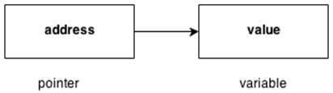
3 Types Data types
Pointer Data Type
The pointer in C# language is a variable, it is also known as locator or indicator that points to an address of a value.

Slide 17
Operators in c #
Arithmetic Operators
Relational Operators
Logical Operators
Bitwise Operators
Assignment Operators
Misc Operator

Slide 18
Arthemetic Operators variable A holds 10 and variable B holds 20
Operator | Description | Example
+ | Adds two operands | A + B =30
- | Subtracts second operand from the first | A - B =10
* | Multiplies both operands | A * B = 200
/ | Divides numerator by de-numerator | B / A = 2
% | Modulus Operator and remainder of after an integer division | B % A = 0
++ | Increment operator increases integer value by one | A++ = 11
-- | Decrement operator decreases integer value by one | A-- = 9

Slide 19
Relational Operators
Operator | Description | Example
== | Checks if the values of two operands are equal or not, if yes then condition becomes true. | (A == B) is not true.
!= | Checks if the values of two operands are equal or not, if values are not equal then condition becomes true. | (A != B) is true.
> | Checks if the value of left operand is greater than the value of right operand, if yes then condition becomes true. | (A > B) is not true.
< | Checks if the value of left operand is less than the value of right operand, if yes then condition becomes true. | (A < B) is true.
>= | Checks if the value of left operand is greater than or equal to the value of right operand, if yes then condition becomes true. | (A >= B) is not true.
<= | Checks if the value of left operand is less than or equal to the value of right operand, if yes then condition becomes true. | (A <= B) is true.

Slide 20
Logical Operators
Operator | Description | Example
&& | Called Logical AND operator. If both the operands are non zero then condition becomes true. | (A && B) is false.
|| | Called Logical OR Operator. If any of the two operands is non zero then condition becomes true. | (A || B) is true.
! | Called Logical NOT Operator. Use to reverses the logical state of its operand. If a condition is true then Logical NOT operator will make false. | !(A && B) is true.

Slide 21
Bitwise Operators
Assume if A = 60; and B = 13; then in the binary format they are as follows −
A = 0011 1100
B = 0000 1101
-------------------
A&B = 0000 1100
A|B = 0011 1101
A^B = 0011 0001
~A = 1100 0011

Slide 22
Bitwise Operators
Operator | Description | Example
& | Binary AND Operator copies a bit to the result if it exists in both operands. | (A & B) = 12, which is 0000 1100
| | Binary OR Operator copies a bit if it exists in either operand. | (A | B) = 61, which is 0011 1101
^ | Binary XOR Operator copies the bit if it is set in one operand but not both. | (A ^ B) = 49, which is 0011 0001
~ | Binary Ones Complement Operator is unary and has the effect of 'flipping' bits. | (~A ) = -61, which is 1100 0011 in 2's complement due to a signed binary number.
<< | Binary Left Shift Operator. The left operands value is moved left by the number of bits specified by the right operand. | A << 2 = 240, which is 1111 0000
>> | Binary Right Shift Operator. The left operands value is moved right by the number of bits specified by the right operand. | A >> 2 = 15, which is 0000 1111

Slide 23
Assignment Operators
Operator | Description | Example
= | Simple assignment operator, Assigns values from right side operands to left side operand | C = A + B assigns value of A + B into C
+= | Add AND assignment operator, It adds right operand to the left operand and assign the result to left operand | C += A is equivalent to C = C + A
-= | Subtract AND assignment operator, It subtracts right operand from the left operand and assign the result to left operand | C -= A is equivalent to C = C - A
*= | Multiply AND assignment operator, It multiplies right operand with the left operand and assign the result to left operand | C *= A is equivalent to C = C * A
/= | Divide AND assignment operator, It divides left operand with the right operand and assign the result to left operand | C /= A is equivalent to C = C / A
%= | Modulus AND assignment operator, It takes modulus using two operands and assign the result to left operand | C %= A is equivalent to C = C % A
<<= | Left shift AND assignment operator | C <<= 2 is same as C = C << 2
>>= | Right shift AND assignment operator | C >>= 2 is same as C = C >> 2
&= | Bitwise AND assignment operator | C &= 2 is same as C = C & 2
^= | bitwise exclusive OR and assignment operator | C ^= 2 is same as C = C ^ 2
|= | bitwise inclusive OR and assignment operator | C |= 2 is same as C = C | 2

Slide 24
Miscellaneous Operators
Operator | Description | Example
sizeof() | Returns the size of a data type. | sizeof(int), returns 4.
typeof() | Returns the type of a class. | typeof(StreamReader);
& | Returns the address of an variable. | &a; returns actual address of the variable.
* | Pointer to a variable. | *a; creates pointer named 'a' to a variable.
? : | Conditional Expression | If Condition is true ? Then value X : Other wise Value Y
Is | Determines whether an object is of a certain type. | If( Ford is Car) // checks if Ford is an object of the Car class.
as | Cast without raising an exception if the cast fails. | Object obj = new StringReader("Hello");StringReader r = obj as StringReader;

Slide 25
String Formatters:
A string Format method is used to insert the value of the variable or an object or expression into another string.
Example:
int a=10,b=20;
String.Format(“The value of a = {0} and b = {1}”,a,b);
String.Format($“The value of a = {a} and b = {b}”);

Slide 26
Number Formats :
CHARACTER | DESCRIPTION | USAGE | EXAMPLE
c | Currency | {0:c} | $ 55,674.74
e | Scientific | {0:e} | 5.567474e+004
f | Fixed point | {0:f} | 55674.74
g | General | {0:g} | 55674.73789621
n | Thousand Separator | {0:n} | 55,674.74

Slide 27
Custom Formats:
CHARACTER | DESCRIPTION | USAGE | EXAMPLE
0 | Zero Placeholder | {0:00.00} | 55674.74
# | Digit Placeholder | {0:(#).##} | (55674).74
. | Decimal Point | {0:0.000} | 55674.738
, | Thousand Separator | {0:0,0} | 55,675
% | Percent | {0:0%} | 5567474%

Slide 28
Date and time formats:
CHARACTER | DESCRIPTION | USAGE | EXAMPLE
d | Short Date | {0:d} | 19-03-2021
D | Long Date | {0:D} | 19 March 2021
t | Short Time | {0:t} | 06:49:20
T | Long Time | {0:T} | 06:49:20
f or F | Long Date Time | {0:f} | 19 March 2021 06:49:00
g or G | Short Date Time | {0:g} | 19-03-2021 06:49:44
M | Short Date | {0:M} | March 19
r | RFC1123 Date Time String | {0:r} | Thu, 19 March 2021 06:49:22 GMT
s | Sortable Date/Time | {0:s} | 2021-03-19T06:49:11
u | Universal Sortable Date | {0:u} | 2021-03-19 06:49:49Z
U | Universal full date | {0:U} | 19 March 2021 00:18:55
Y | Year month pattern | {0:Y} | March, 2021

Slide 29
Thank You

